Slide 1
Voltage regulator testing results from 2021.11.08
Goal: characterize ripple and efficiency of S-85S1AB18-I6T1U with different passive components
Sulu boards in different configurations
DC1: Recommended 10 uF C_in, 10 uF C_out, and inductor
DC2: Old 10 uF C_in,10 uF C_out, and old inductor from Spock
L6 board with Sulu 10 uF C_in, 100 uF C_out, and old inductor
9 datapoints for 3 V = V_ext with no series resistance
3 Sulu configurations
3 resistive loads: ~0.15 mA, ~0.34 mA, and ~1.5 mA
4 datapoints for 4 V = V_ext with 1 kOhm series resistance
DC1 and L6
Confluence page: https://crystalfree.atlassian.net/wiki/spaces/SCUM/pages/1949859841/Voltage+Regulators

Slide 2
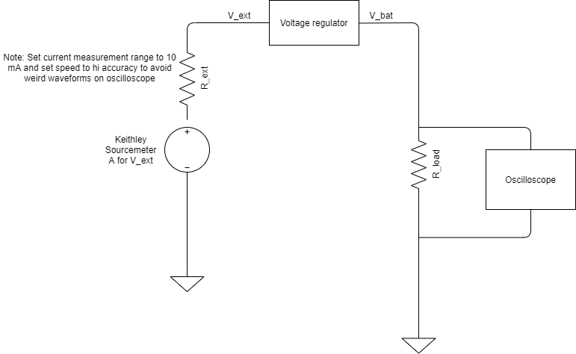
Testing setup

Slide 3
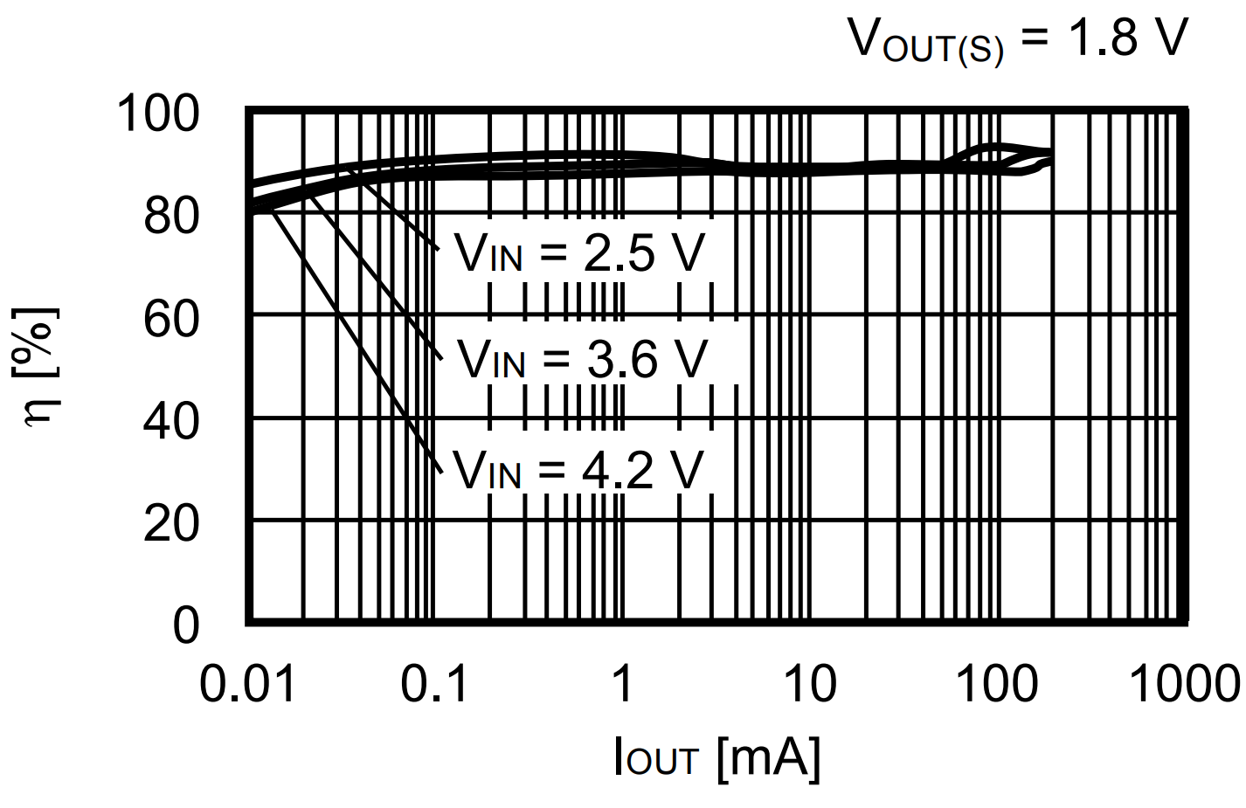
Efficiency
DC1: Recommended 10 uF C_in, 10 uF C_out, and inductor
DC2: Old 10 uF C_in,10 uF C_out, and old inductor from Spock
L6 SCuM board with 10 uF C_in, 100 uF C_out, and old inductor
No power supply series resistance
Datasheet efficiency
Measured efficiency = (voltage out)*(current out) / [ (voltage in)*(current in) ]

Slide 4
Waveforms @ 1.5 mA
R_load = 1.2 kOhm
V_ext = 3 V
R_ext = zero
Measured V_bat = 1.8 V
DC1: Recommended 10 uF C_in, 10 uF C_out, and inductor
DC2: Old 10 uF C_in,10 uF C_out, and old inductor from Spock
L6 board with Sulu 10 uF C_in, 100 uF C_out, and old inductor

Slide 5
Waveforms @ 0.34 mA
R_load = 5.3 kOhm
V_ext = 3 V
R_ext = zero
Measured V_bat = 1.8 V
DC1: Recommended 10 uF C_in, 10 uF C_out, and inductor
DC2: Old 10 uF C_in,10 uF C_out, and old inductor from Spock
L6 board with Sulu 10 uF C_in, 100 uF C_out, and old inductor
Lost the .png ☹

Slide 6
Waveforms @ 0.15 mA
R_load = 12 kOhm
V_ext = 3 V
R_ext = zero
Measured V_bat = 1.8 V
DC1: Recommended 10 uF C_in, 10 uF C_out, and inductor
DC2: Old 10 uF C_in,10 uF C_out, and old inductor from Spock
L6 board with Sulu 10 uF C_in, 100 uF C_out, and old inductor

Slide 7
Waveforms @ 1.5 mA
R_load = 1.2 kOhm
V_ext = 4 V
R_ext = 1 kOhm
Measured V_bat = 1.5 V
DC1: Recommended 10 uF C_in, 10 uF C_out, and inductor
L6 board with Sulu 10 uF C_in, 100 uF C_out, and old inductor

Slide 8
Waveforms @ 0.15 mA
R_load = 12 kOhm
V_ext = 4 V
R_ext = 1 kOhm
DC1: Recommended 10 uF C_in, 10 uF C_out, and inductor
Measured V_bat = 1.8 V
L6 board with Sulu 10 uF C_in, 100 uF C_out, and old inductor
Measured V_bat = 1.5 V

Slide 9
Next steps
Try connecting IMU to 1.8 V DC-DC regulator
With Spock components to identify ripple
Test traces on Sulu PCB
Spock v1.0 schematic (?)

Slide 10
Questions
Which boards worked with the radio?
As I recall, Sulu mostly worked, Spock 1.0 was where the ripple was noticed
Spock v1.0 schematic (?)

Slide 11
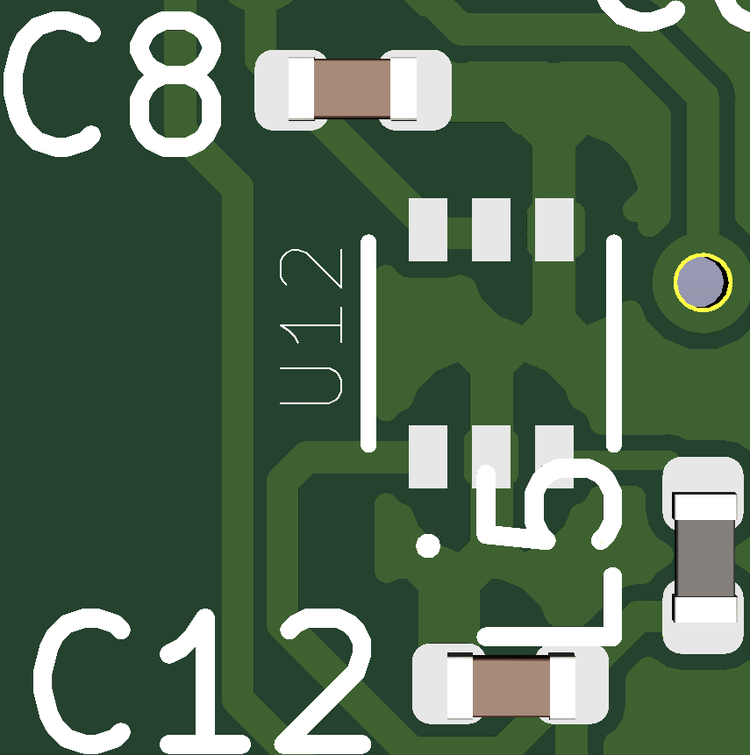
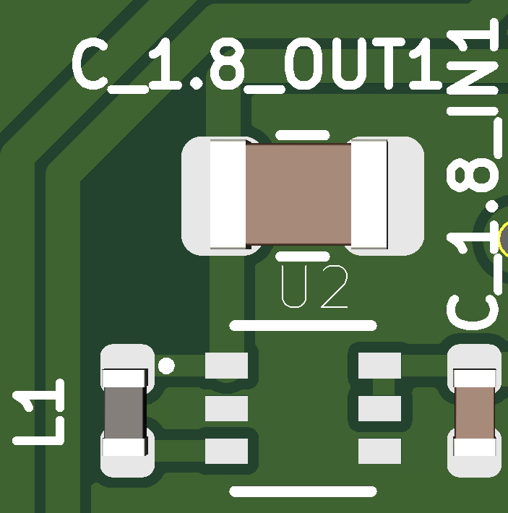
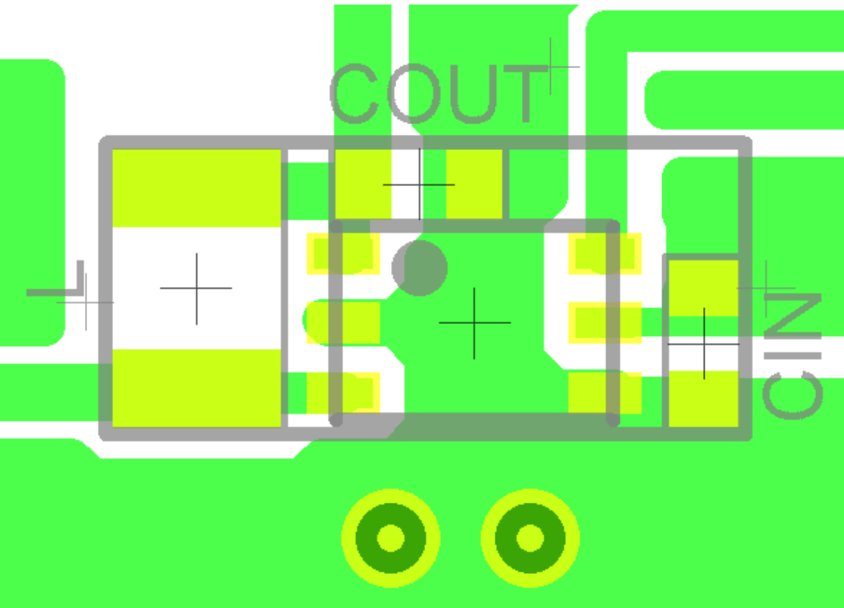
Layout differences between Spock v1.0 and Sulu v1.0
cin
cout
Spock v1.0 layout (?)
Sulu v1.0 layout
Datasheet layout

