Slide 1
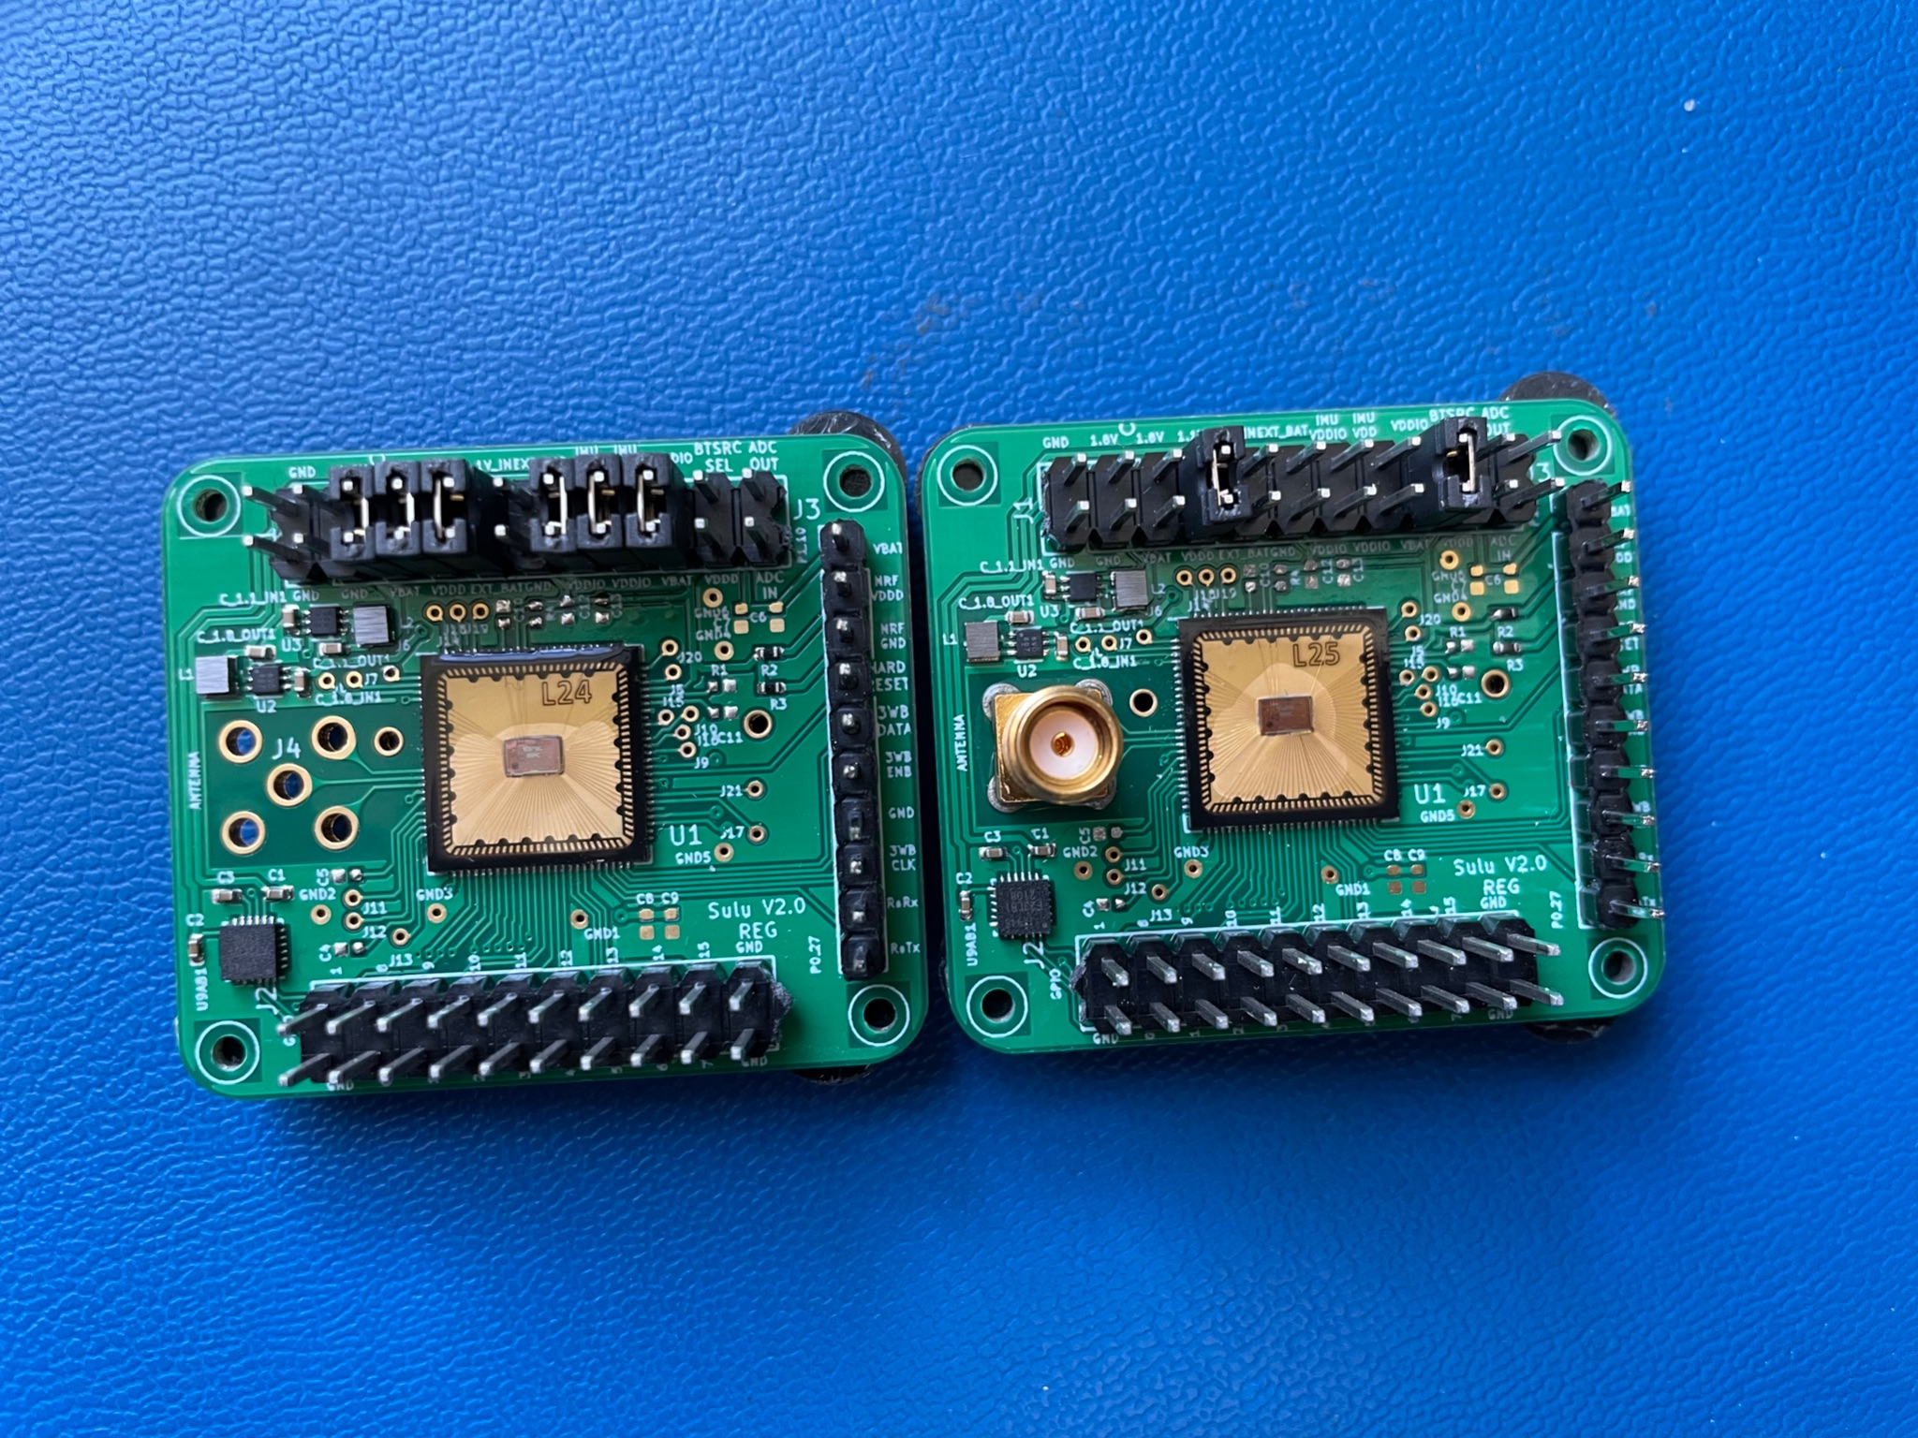

Slide 2
What’s working
What’s not working
IMU
UART Tx on L24
TX to OpenMote
3WB programming
optical programming
DC DC supplies for 1.8V and 1.1V
Powering the boards through nRF 5V source
UART on L25 has weirdness

Slide 3
Initial Current Strange
On both boards current on EXT_BAT (5V from external power supply) was 160uA before board programmed. Boards still boot fine. Anecdotally current consumption on the board was lower than I generally had seen (maybe by roughly ~100 to ~200 uA)
Setup:
1.1V DCDC source connected to VDDD
1.8V DCDC source connected to VBAT
VDDIO connected to 1.8V

Slide 4
Board testing:
L24
1.1V outputting correctly
1.8V outputting correctly
Can transmit packets to Open Mote
Can read data sent over UART from SCuM
No SMA connector
Austin observation: current was 160uA using VBAT DCDC, but programs perfectly fine
UART garbled on Austin’s code, but works with Josh’s binary
Changed set_VDDD_LDO_voltage(0); to set_VDDD_LDO_voltage(65); and that helped UART output on this board????
IMU test
With IMU VDDIO and IMU VDD at 1.8V the board draws 3mA unprogrammed
1.5mA when polling IMU at 10Hz
IMU works!!!! Seems like the acceleration values are changing according to the rotation
TX works over 3WB. UART did not work when using 3WB programming (still garbled). -33 RSSI TX (Note using Keithley for power, but tested and also works from nRF 5V)
L25
400uA with VBAT 1.8V
1.12V outputting correctly
1.8V source outputting correctly!
160uA on VBAT when using 1.8V DCDC source
UART has a couple OK lines, but mostly garbled
Radio transmit works and packets come in without corruption!
Fixed TX working!!!!!
UART not working even after my VDDD LDO voltage change when using my code, but UART works when running Fil’s code
Current is just so much higher with Fil’s code

