Slide 1
Polytec EC 151-L
Cures at 120 C
Difficult to heat on hot plate, need cover
Very weak connection after cured
Despite applying a lot of epoxy to hole
Believe it may be too non-viscous
Measured 50 Ohm resistance after cured
https://www.intertronics.co.uk/wp-content/uploads/2016/10/Polytec-Electrically_Conductive_Adhesives.pdf

Slide 2
8331 Silver Epoxy
Cures at 65 C
Very difficult to apply to headers
Believe it may be too viscous
Came out of tube extremely thick
Believe version we have may be too old
https://www.mgchemicals.com/prcoducts/adhesives/electrically-conductive-adhesives/silver-conductive-epoxy/

Slide 3
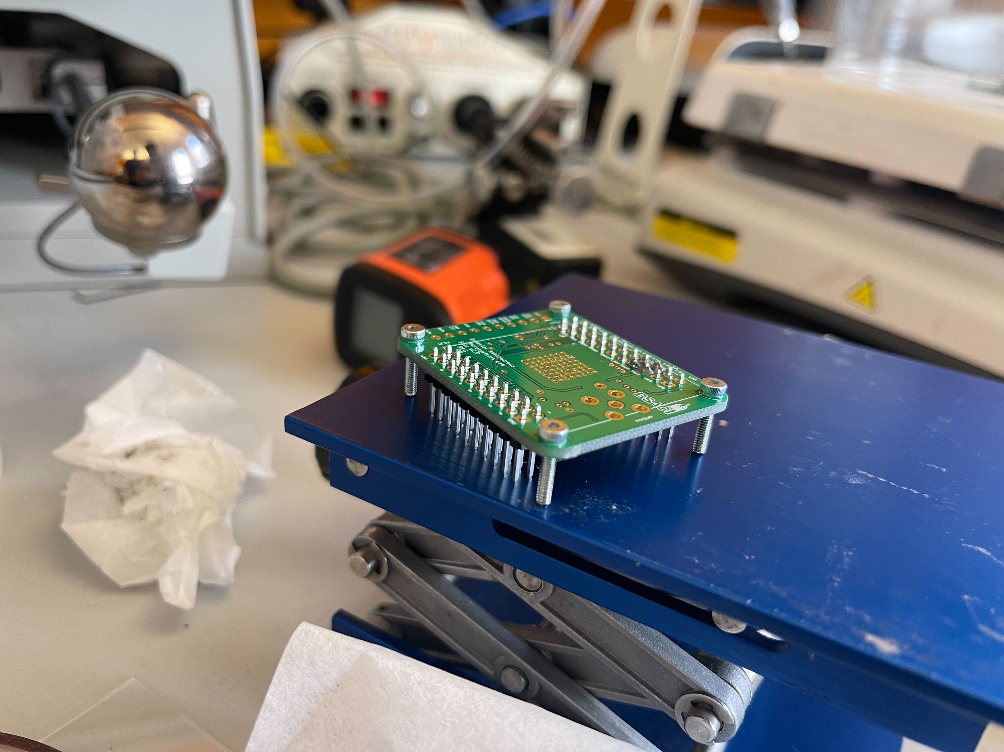
Sn42/Bi57.6/Ag0.4 ChipQuik Solder Paste
Melts at 138 C, reaches 175 C for reflow
Worked according to tests so far
Need to apply a lot
Much less solder still connected after process
Do not adjust pin headers until it has cooled
Look for shiny visual cool before turning off hot plate
Let bottom of headers be just above hot plate
https://www.chipquik.com/store/product_info.php?products_id=440001
Mounting used:

