Slide 1
EEG/MRI/TMS
June 8, 2022
SCuM Meeting
Yu-Chi

Slide 2
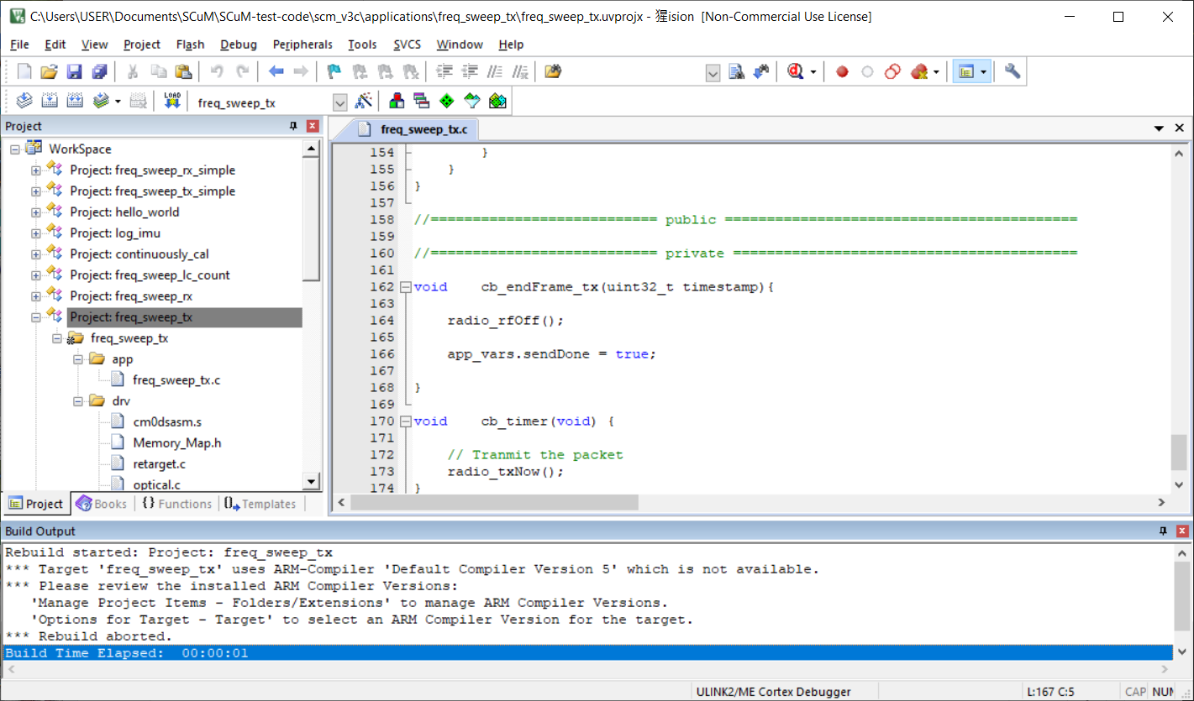
Keil install issue
current version: MDK537.exe uses compiler 6 and doesn’t support compiler 5
[sol] use older version .exe MDK525.exe from Alex

Slide 3
Openmote packets receiving issue
SCuM transmit + Openmote receiving
freq_sweep_rx_simple
UART is receiving data
no issue on Alex’s setup
tried delete /tmp -> improved but not solved

Slide 4
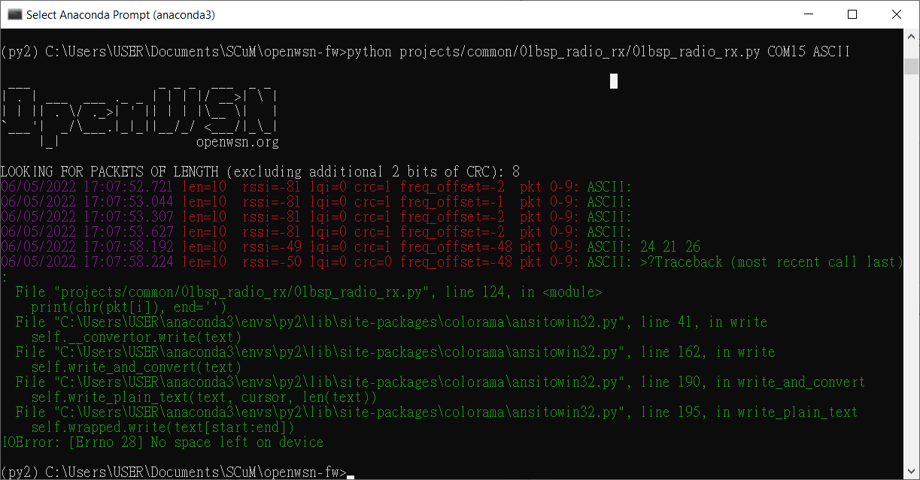
Openmote packets receiving issue
SCuM transmit + Openmote receiving
freq_sweep_rx_simple
UART is receiving data
working on Alex’s setup
tried delete /tmp -> improve but still

Slide 5
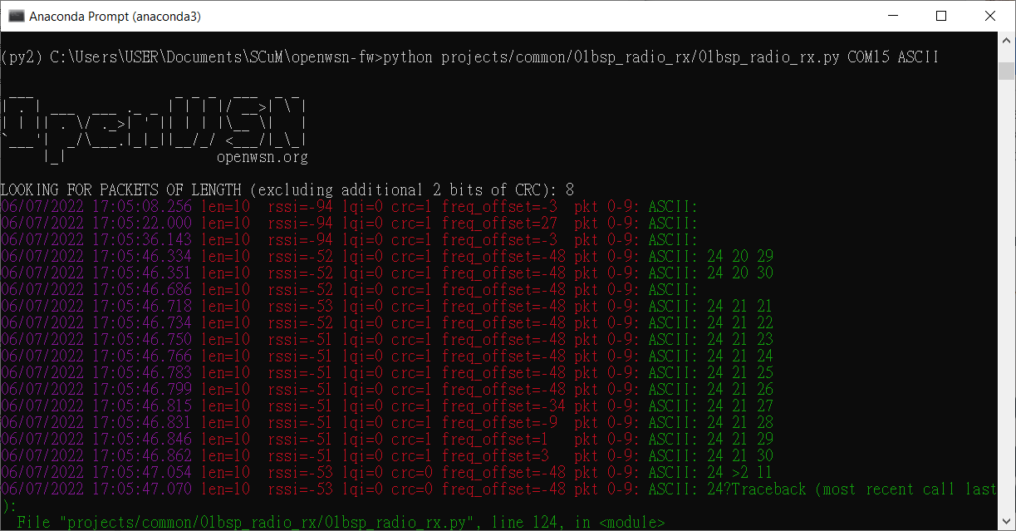
Openmote packets receiving issue
SCuM transmit + Openmote receiving
freq_sweep_rx_simple
UART is receiving data
working on Alex’s setup
tried delete /tmp -> improve but still

