Slide 1
Lighthouse Localization of Single Chip Micro Mote
Brian Kilberg - May 2021
Professor Kris Pister
presented by Abanob Bostouros

Slide 2
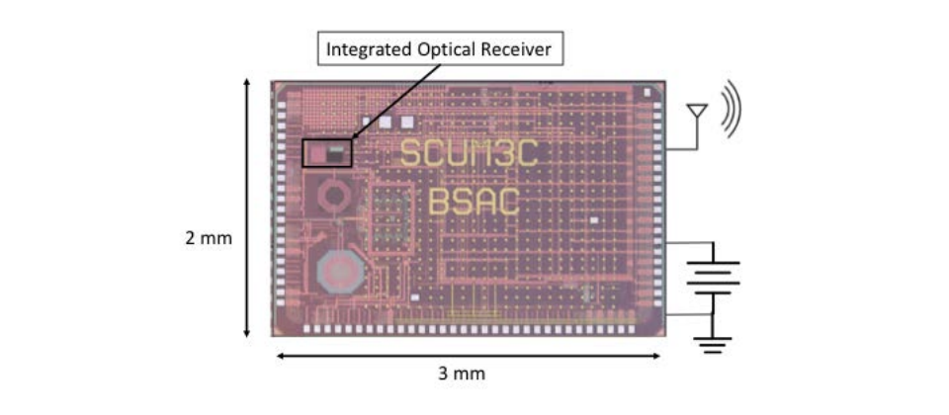
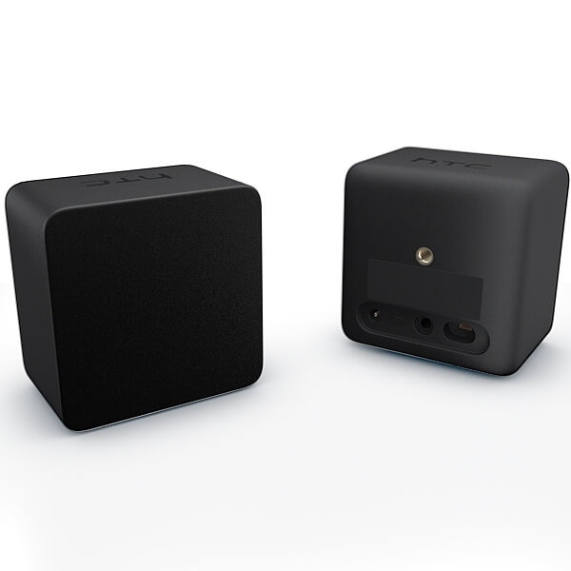
Importance of 3D localization
Localizing SCµM will allow us to use it in Micro-robots, virtual reality, invisible keyboard, … etc
SCuM there are other forms of localization GPS, ultrasonic, however this requires additional hardware. This is where the optical programmer can save us through lighthouse localization.

Slide 3
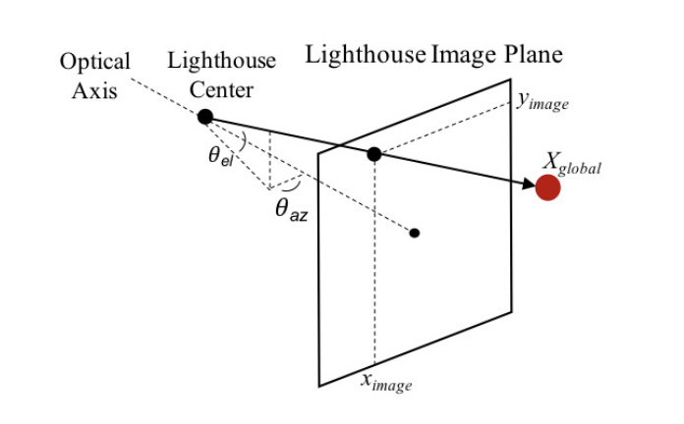
Lighthouse localization plan

Slide 4
Lighthouse sweeping demo

Slide 5
HTC Vive V1
ω Δt = Θ

Slide 6
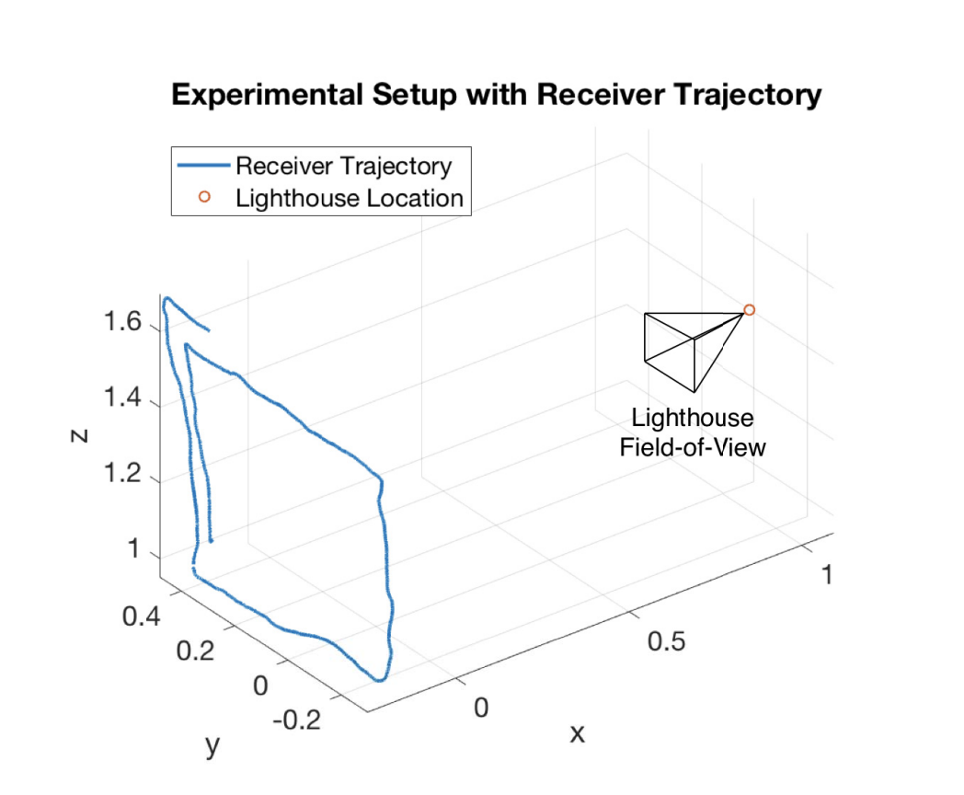
Validation experiment
The optical receiver chip was moved through a trajectory while tracking itself using the IR pulses and sweeps from the lighthouse beacon.
The ground truth of the receiver’s trajectory was obtained using an Optitrack motion capture system.

Slide 7
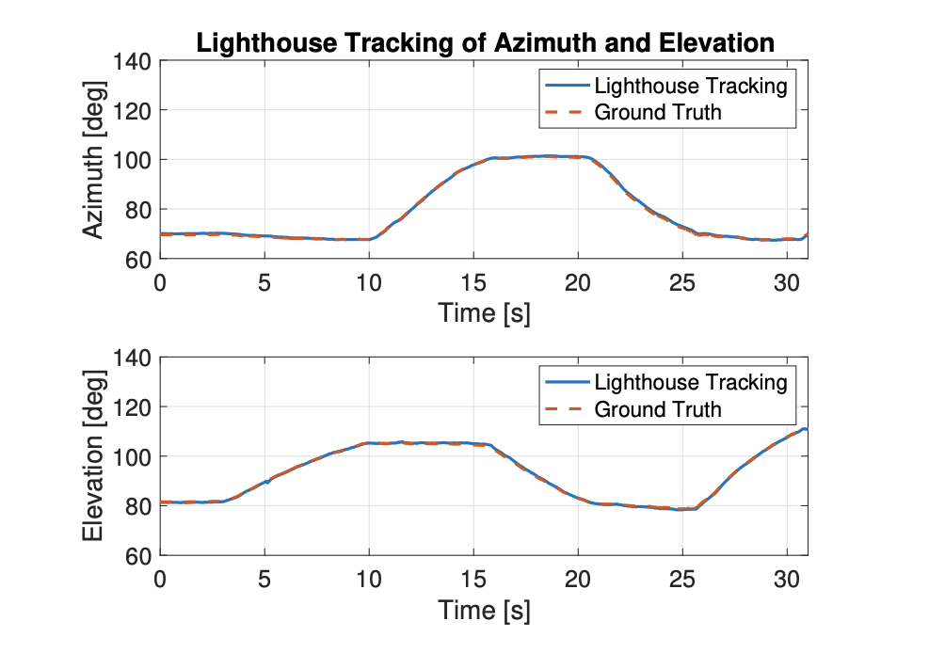
Experiment results
Azimuth tracking’s RMS error was 0.386 degrees.
Elevation tracking’s RMS error was 0.312 degrees.

Slide 8
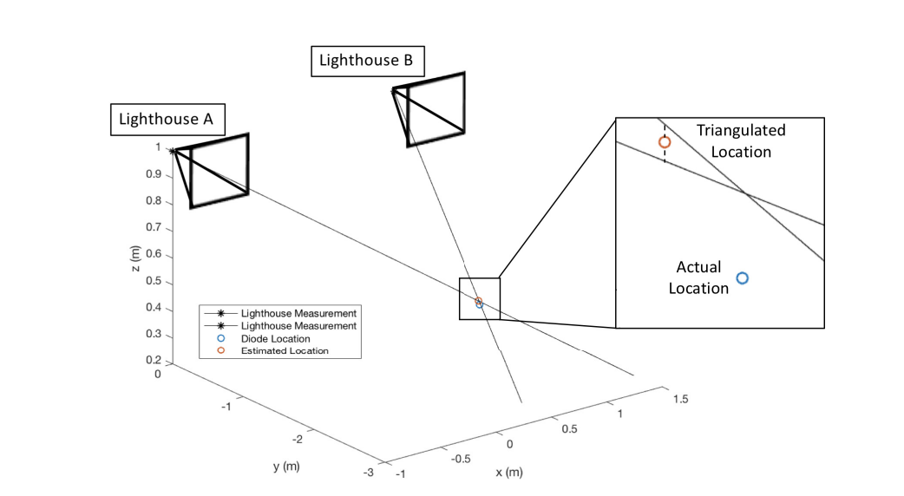
Triangulation and calibration
Modeling each lighthouse base station as a camera allows for both calibration of relative poses of each lighthouse in addition to the use of triangulation methods
Used 1000 sample points of the SCµM angle data projected onto the unit distance image plane, and their corresponding ground truth 3D position data to use OpenCV’s solvePnPRansac method.

Slide 9
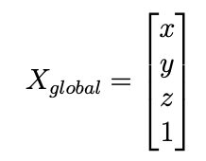
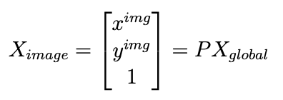
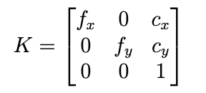
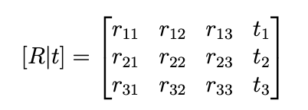
Calibration of Lighthouse Projection Matrices
The azimuth and elevation measurements (range 0-π, with π/2 corresponding to the laser perpendicular to the image plane) are projected at unit distance onto this plane
The center of rotation of the lighthouse laser scans is the pinhole and the intrinsic matrix is I.

Slide 10
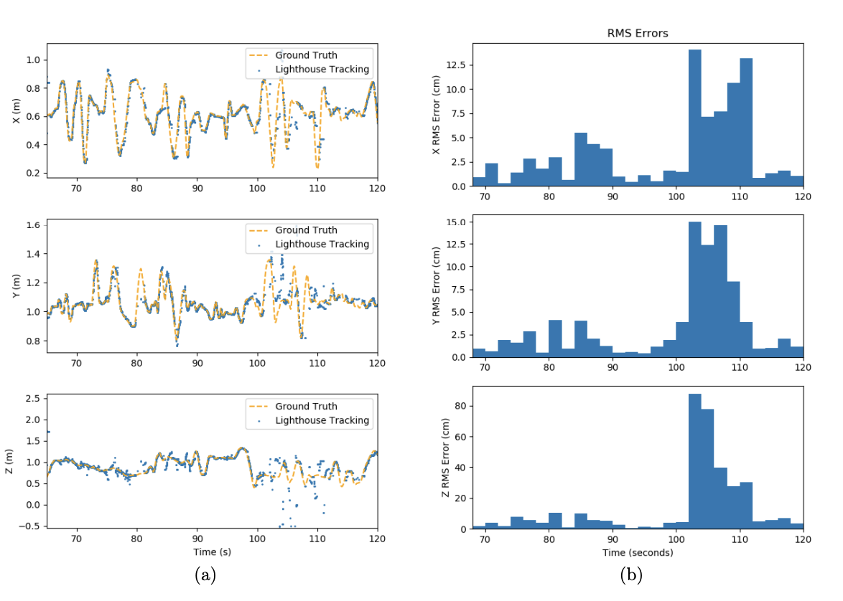
Results
In our system, a missed measurement gets replaced by the latest measurement.
causes the reconstruction algorithm to use out-of-date measurements, resulting in inaccurate positioning.

Slide 11
Next steps
Rebuild the experiment
Design scalable and reliable system to test multi-scum
Use regular 5-point algorithm to recover Essential Matrix
Use essential matrix and static setting to recover projection matrix
communicate the coordinates only with the ground station
Test new triangulation method and combine IMU data
combine IMU and recovered 3D position on chip
Notes:
scalable & reliable -> discover processing power for on chip computation
also talk about my current progress

