Slide 1
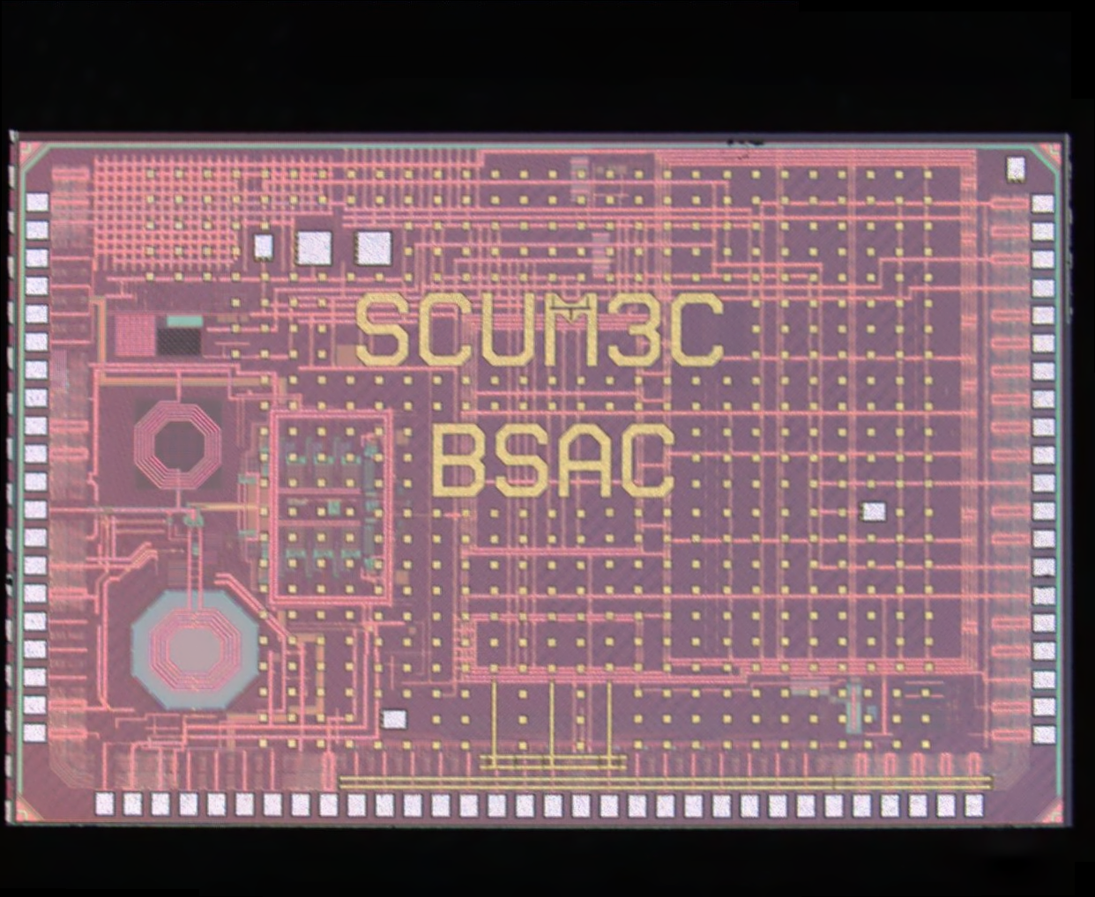
SCuM “Single Chip Micro-mote”, Ver. 3C
Actual size
10× Magnification
20× Magnification
40× Magnification
100× Magnification

Slide 2
SCuM “Single Chip Micro-mote”, Ver. 3C
Actual size
80× Magnification

